Slide 1
Predicting the Price of Used Cars
Babawale Olatunji
Regis university
Msds 692 data science practicum I

Slide 2
Problems & Project Purpose:
Predicting the price of used cars is a challenging task.
This is due to several features that should be examined for accurate prediction.
Potential used car buyers do not know if they are paying too much for the asking price of used cars.
The purpose of this data science practicum project is to develop a machine learning model that can be leveraged in predicting price of used cars.

Slide 3
Dataset
This project used Kaggle data set located at https://www.kaggle.com/orgesleka/used-cars-database to achieve its objectives.
The Data-Set contains offerings of used cars in Germany.
The data set contains over 370,000 used cars information with 20 attributes .
The data set contains some missing values that require data cleaning to increase prediction performance and accuracy.

Slide 4

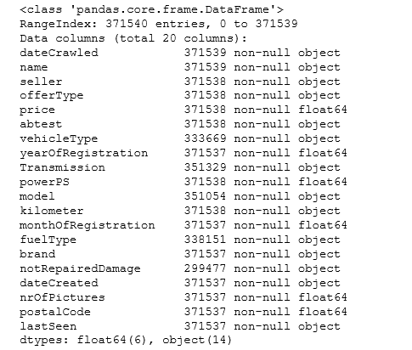
Knowing the dataset
The dataset is consist (14) string variables and (6) numerical variables

Slide 5
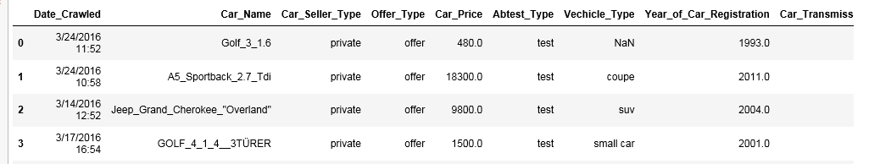
The dataset
The following depicts the first few lines of the dataset.

Slide 6
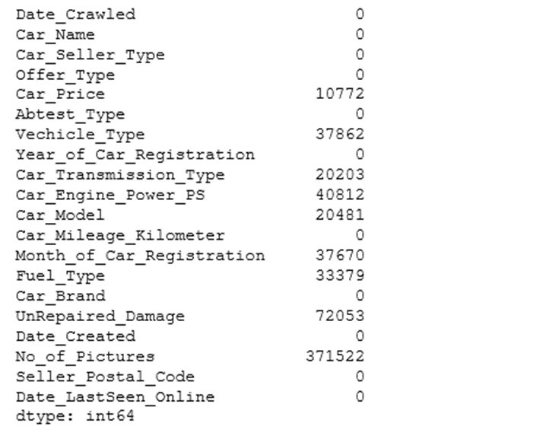
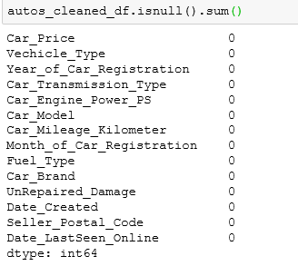
Data Cleaning
There are missing values identified as Nans/null in the dataset.
The data also used zeros (0.0) as missing values.
Dealt with missing values by dropping the rows and columns that contain them.
Null values would result in bias resulting from differences between missing and complete data

Slide 7
Data Cleaning - Cont’d
The dataset also contains Outliers.
These are values or observations that are distant from other observations in the column.
Outliers were identified from relevant columns and removed.
Outliers would have a positive or negative effect on the correlation of the data if not handled correctly.
Converted strings to categorical variables.
Converted strings to dates as datetime objects.

Slide 8
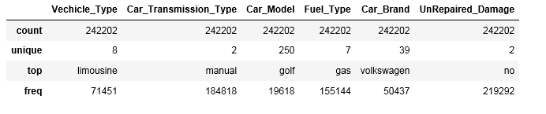
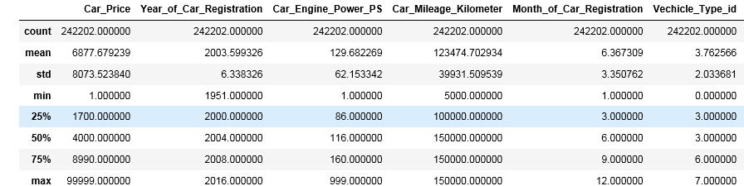
Exploratory Data Analysis – Summary Statistics

Slide 9
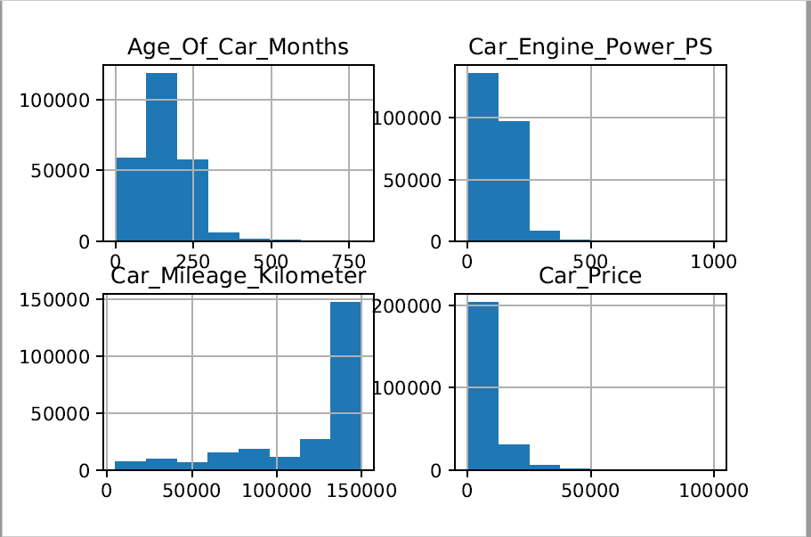
Exploratory Data Analysis – Histograms of Numerical Attributes

Slide 10
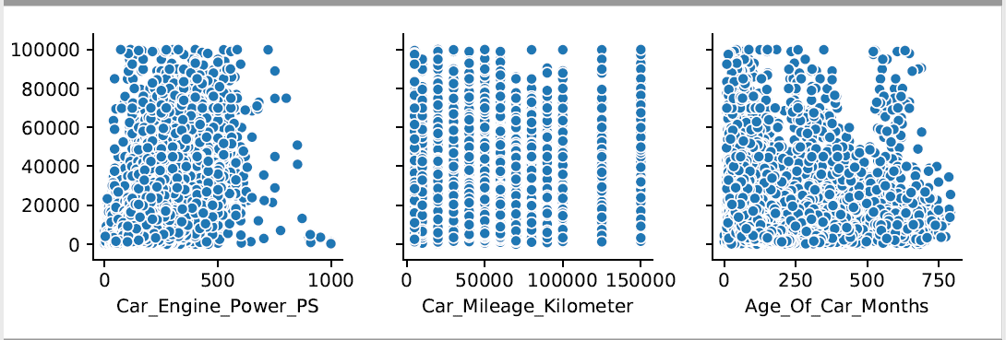
Exploratory Data Analysis – Car Price and Numerical Attributes Pair Plots

Slide 11
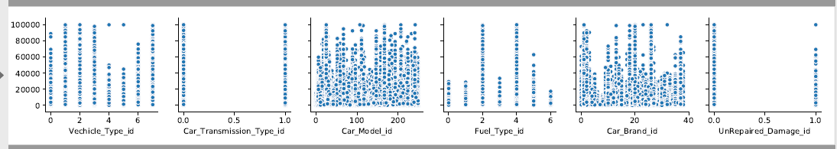
Exploratory Data Analysis – Car Price and Categorical Attributes Pair Plots

Slide 12
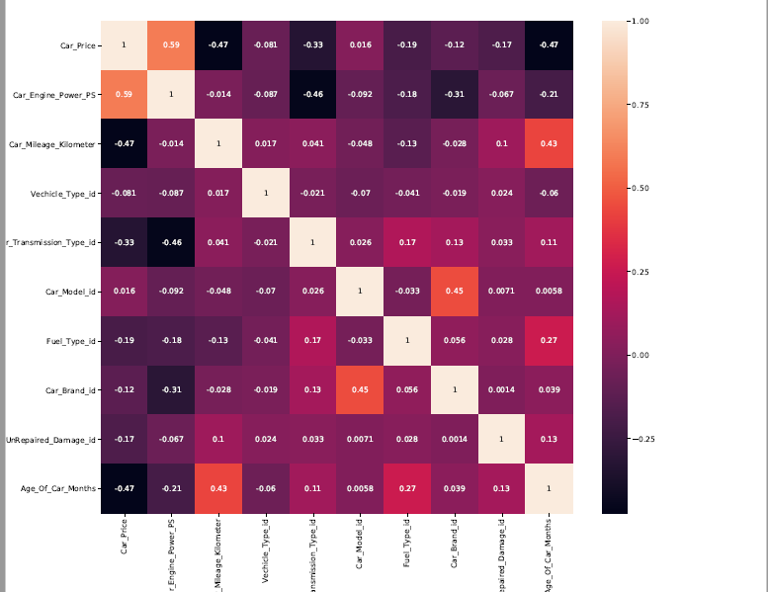
Correlation of Data

Slide 13
Splitting data into Test and Train Sets
The dataset was split into training data and testing data.
The training data is the data that the model would leverage for learning.
The Test data is the data that would be leveraged to measure the performance of our models on unseen data.

Slide 14
Training models
There are two types of supervised machine learning algorithms including Regression and Classification.
Predicting the Price of a Used Car is a regression problem.
Different types of regression models can be implemented using Python Scikit-Learn.
The Scikit-learn is a Python machine learning library.
The training dataset would be trained or fitted using 4 different regression models including Linear Regression, Decision Tree Regression, Random Forest Regression and Ensemble (Voting Regressor).

Slide 15
Accuracy Predictions
Get the predictions by providing the test data to the Linear Regression, Decision Tree Regression, Random Forest Regression and Ensemble VotingRegressor models.
This would give us the prediction accuracy score.
The prediction accuracy score from each model would be used as one of the basis to determine the best model.

Slide 16
Linear Regression Model
In linear regression, a model is constructed that enables us to predict the value of new data considering the training data used to train the model.
Fit or Train the training data to Linear Regression.
Prediction Accuracy Score of this model is 62%.
Root Mean Squared Error (RMSE) Metric – 4960.
Linear Regression Model RMSE metric for predicting the response (y) is 4960.
A lower value of RMSE metric is preferable.

Slide 17
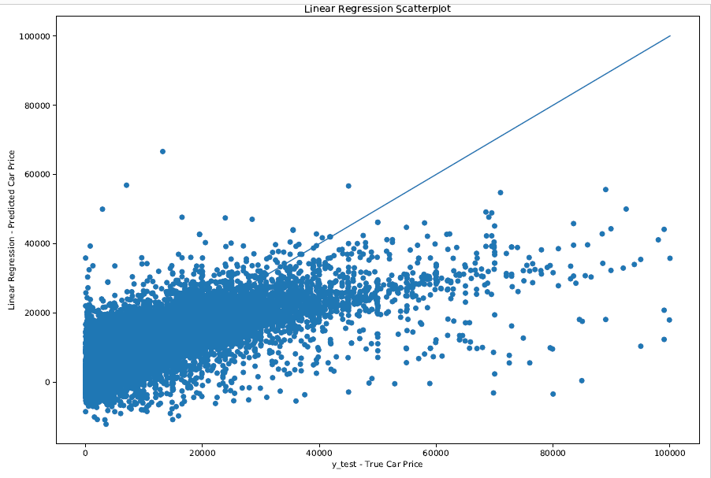
Linear Regression Model - Scatterplot

Slide 18
Decision Tree Regression Model
Decision Tree Regression Model is the second model constructed for this project.
Decision Tree trains a model in a tree like structure to predict data in the future
Fit or Train the training data to Decision Tree Regression.
Prediction Accuracy Score of this model is 82%.
Root Mean Squared Error (RMSE) Metric – 3420.
Decision Tree Regression Model RMSE metric for predicting the response (y) is 3420.

Slide 19
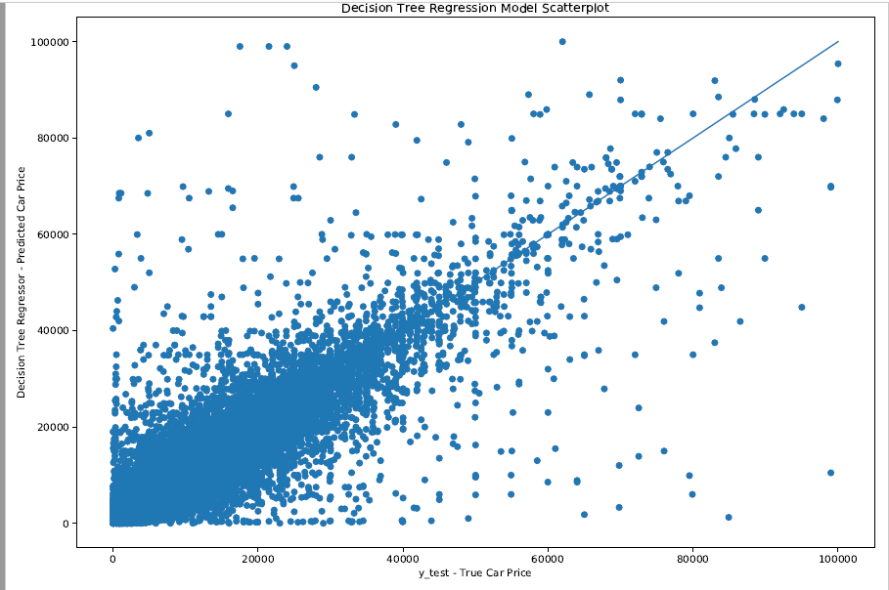
Decision Tree Regression Model - Scatterplot

Slide 20
Random Forest Regression Model
Random Forest Regression Model is the third model constructed for this project.
It combines multiple decision trees in determining the final output.
Fit or Train the training data to Random Forest Regression.
Prediction Accuracy Score of this model is 89%.
Root Mean Squared Error (RMSE) Metric – 2675.
Random Forest Regression Model RMSE metric for predicting the response (y) is 2675.

Slide 21
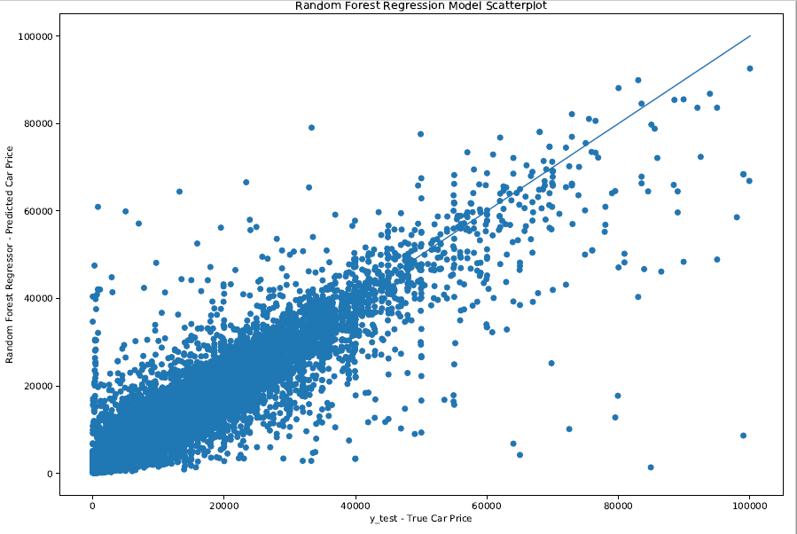
Random Forest Regression Model - Scatterplot

Slide 22
Ensemble VotingRegressor Model
Ensemble Voting Regressor fits Linear Regressor, Decision Tree Regressor and Random Forest Regressor each on the training dataset.
Fit or Train the training data to Ensemble VotingRegressor.
Prediction Accuracy Score of this model is 86%.
Root Mean Squared Error (RMSE) Metric – 2985.
Ensemble VotingRegressor Model RMSE metric for predicting the response (y) is 2985.

Slide 23
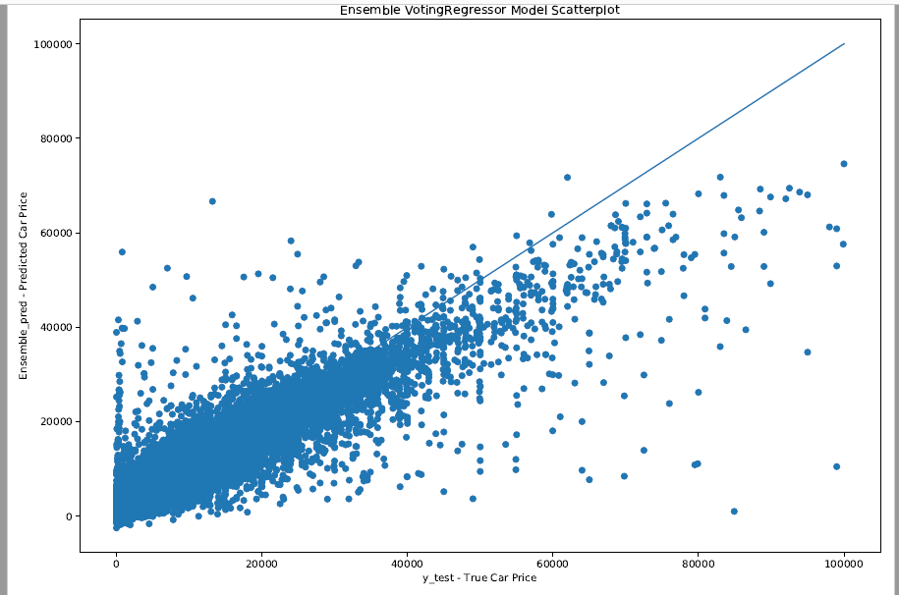
Ensemble VotingRegressor Model - Scatterplot

Slide 24
Conclusion
Random Forest Regression Model provides the best prediction accuracy out of the four models.
Random Forest also provides the best RMSE metric for predicting the response (y).
Hence, Random Forest Regression Model is the selected model for predicting the price of used car.
The project showcases Car Power Engine, Car Mileage, and the Car’s Age are the three most important features in predicting the price of a used car.

Slide 25
Project Repository
The python code and the plots for this project is located at https://github.com/BOLATUNJI/PracticumI---Predicting-the-Price-of-Used-Cars
Project Dataset - https://www.kaggle.com/orgesleka/used-cars-database

Slide 26
Thank you!

